Slide 1
PRESENTATION ON TIME MANAGEMENT as and enterprise skill

Slide 2
What is time management ?
Time management is the process of organizing and planning how to divide your time between different activities.
Effective time management comes easier to some people than others, but everyone can develop habits to improve their time management skills.
Without strong time management, your work and wellbeing can suffer and it can lead to:

Slide 3
Producing poor quality work.
Missing deadlines.
Increasing your stress levels.
Ruining your work-life balance.
Harming your professional reputation.

Slide 4
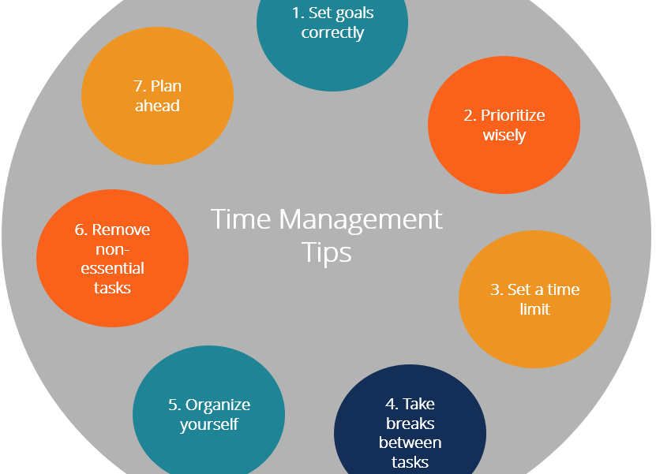
Tips to better manage your time as an enterprise skill

Slide 5
Importance of Time Management
Below, are stated reasons why time management is considered importance:
It boosts productivities: Being able to Manage your time, helps you to be productive in your daily task . You are able to achieve the goals you set for yourself.
It assists you to prioritize : you are able to approach your work systematically. You are sure of which task to engage in first.

Slide 6
It reduces stress: Time management reduces your stress. It reduces re-work and mistakes, due to good time organization of your work.
Division of labor : It helps you allocate tasks to your employees, so you could yield good results at the end of the day.
Goal oriented: Time management assists you in improving your focus and setting standards for your business, which you consciously make towards achieving your goals and objectives.

Slide 7
Time management helps you to achieve your daily goals for your business and also, gain desire growth and success that you have always wished for.
Time management is however, a skill that every individual should have and build on, to grow a successful business .

Slide 8
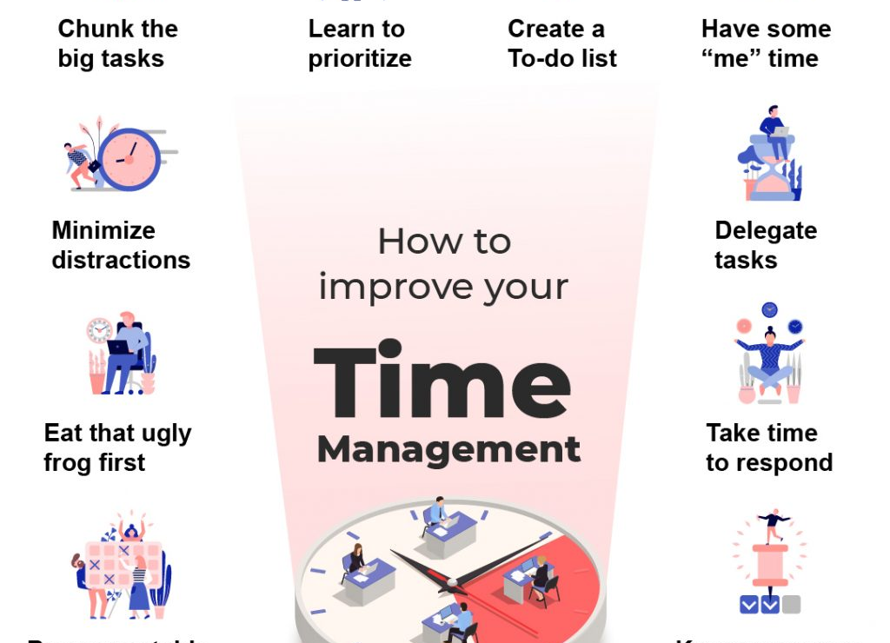
How to improve your time management

